Slide 1
UNIT-5 Code monitoring and Issue Tracking

Slide 2
Code monitoring tools:
What is Continuous code Monitoring?
Continuous code Monitoring is all about the ability of an organization to detect, react, report, respond, contain and mitigate(reducing risk of loss from the occurrence of any undesirable event) the attacks that occur, in its infrastructure.
Once the application is deployed into the server, the role of continuous monitoring comes in to play. The entire process is all about taking care of the company’s infrastructure and respond appropriately.

Slide 3
Why We Need Continuous Monitoring?
Continuous Monitoring Tools resolve any system errors ( low memory, unreachable server etc. ) before they have any negative impact on your business productivity.
It detects any network or server problems
It determines the root cause of any issues
It maintains the security and availability of the service .It monitors and troubleshoot server performance issues
It allows us to plan for infrastructure upgrades before outdated systems cause failures
It can respond to issues at the first sign of a problem
It can be used to automatically fix problems when they are detected
It ensures IT infrastructure outages have a minimal effect on your organization’s bottom line. It can monitor your entire infrastructure and business processes

Slide 4
From past years our security professionals are performing static analysis from – system log, firewall logs, IDS logs, IPS logs etc. But, it did not provide proper analysis and response. Today’s Continuous Monitoring approaches which are automated tools gives us the ability to aggregate all of the events discussed above, co-relate them, compare them and then estimate the organization’s risk posture.

Slide 5
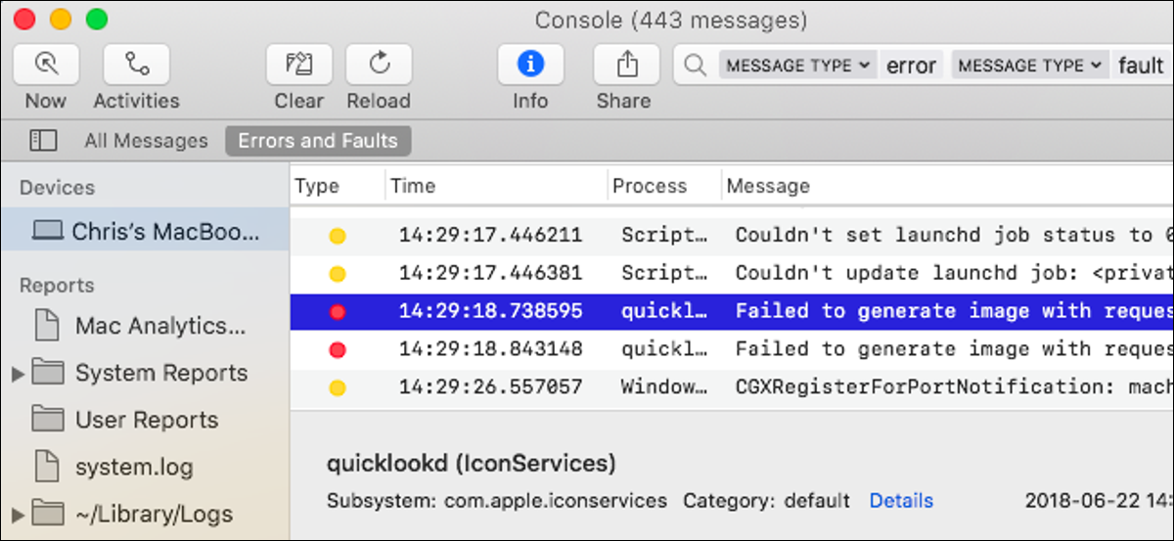
system log

Slide 6
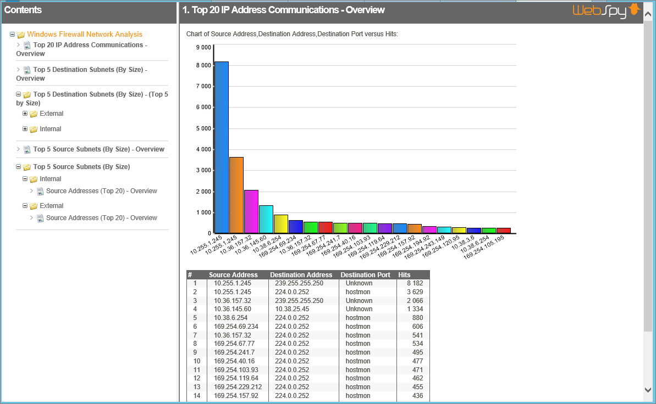
Windows Firewall Logs

Slide 7
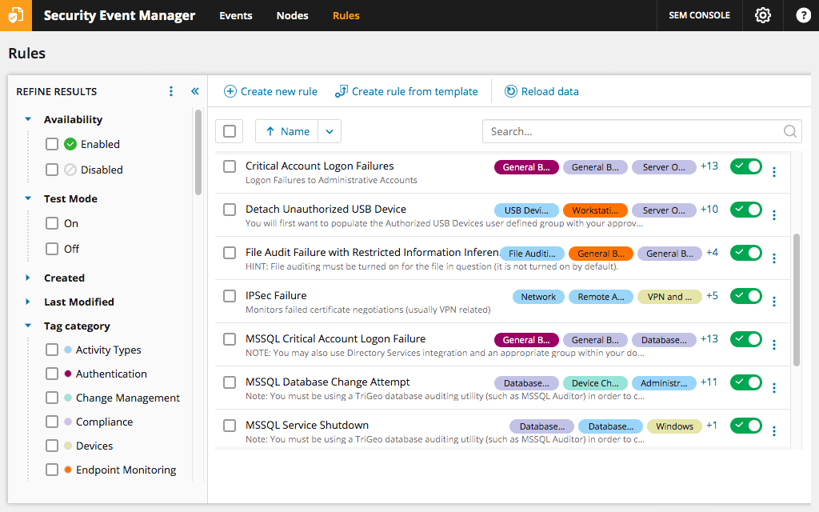
IDS logs (Intrusion Detection System logs)

Slide 8
Continuous code Monitoring, sometimes called Continuous Control Monitoring (CCM), is an automated process by which DevOps personnel can observe and detect compliance issues and security threats during each phase of the DevOps pipeline
So, Continuous code Monitoring is an automated process that leverages specialized software tools to empower DevOps teams with enhanced visibility of application performance, security threats, and compliance concerns across the entire DevOps pipeline.
Continuous code Monitoring comes in at the end of the DevOps pipeline. Once the software is released into production, Continuous Monitoring will notify dev and QA teams in the event of specific issues arising in the prod environment. It provides feedback on what is going wrong, which allows the relevant people to work on necessary fixes as soon as possible.
Continuous monitoring (CM) tools are a critical component of the DevOps pipeline, providing automated capabilities that allow developers to effectively monitor applications, infrastructure, and network components in the production environment.

Slide 9
It also helps teams or organizations monitor, detect, study key relevant metrics, and find ways to resolve said issues in real-time.
We can say Continuous Monitoring basically assists IT organizations, DevOps teams in particular, with procuring real-time data from public and hybrid environments.
This is especially helpful with implementing and fortifying various security measures – incident response, threat assessment, computers, and database forensics, and root cause analysis.
It also helps provide general feedback on the overall health of the IT setup, including deployed software.

Slide 10
Goals of Continuous Monitoring in DevOps
Enhance transparency and visibility of IT and network operations, especially those that can trigger a security breach, and resolve it with a well-timed alert system.
Help monitor software operation, especially performance issues, identify the cause of the error, and apply appropriate solutions before significant damage to uptime and revenue.
Help track user behavior, especially right after an update to a particular site or app has been pushed to prod. This monitors if the update has a positive, negative, or neutral effect on user experience.
Types of Continuous Monitoring
Infrastructure Monitoring: Monitors and manages the IT infrastructure required to deliver products and services. This includes data centres, networks, hardware, software, servers, storage, and the like. Infrastructure Monitoring collates and examines data from the IT ecosystem to improve product performance as far as possible.

Slide 11
Infrastructure Monitoring: Tool must monitor
Server Availability
CPU & Disk Usage
Server & System Uptime
Response Time to Errors
Storage
Database Health
Storage
Security
User permissions
Network switches
Process level usage
Relevant performance trends

Slide 12
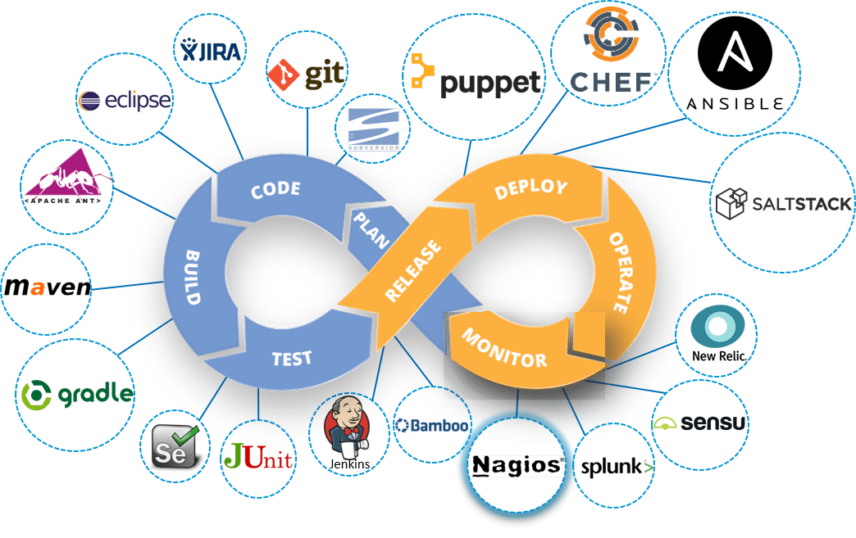
Application Monitoring: Monitors the performance of released software based on metrics like uptime, transaction time and volume, system responses, API responses, and general stability of the back-end and front-end.
Network Monitoring: Monitors and tracks network activity, including the status and functioning of firewalls, routers, switches, servers, Virtual Machines, etc. Network Monitoring detects possible and present issues and alerts the relevant personnel. Its primary goal is to prevent network downtime and crashes.

Slide 13
Application Monitoring: Tool must monitor:
availability
error rate
throughput
user response time
pages with low load speed
third-party resource speed
browser speed
end-user transactions
SLA status

Slide 14
Network Monitoring: Tool must monitor:
Latency
Multiple port level metrics
Server bandwidth
CPU use of hosts
Network packets flow
Apart from these, following things also important to monitor in Continues monitoring…
Server status and health
Application performance log
System vulnerabilities
Development milestones
User activity/behavior

Slide 15
Nagios
What is Nagios?
Nagios is an open source software for continuous monitoring of systems, , applications. networks, infrastructures, services, and business processes etc , in a DevOps culture.
In the event of a failure, Nagios can alert technical staff of the problem, allowing them to begin remediation processes before outages affect business processes, end-users, or customers. With Nagios, you don’t have to explain why an unseen infrastructure outage affect your organization’s bottom line.
It runs plugins stored on a server which is connected with a host or another server on your network or the Internet. In case of any failure, Nagios alerts about the issues so that the technical team can perform recovery process immediately.

Slide 16
Nagios software runs periodic checks on critical parameters of application, network and server resources.
For example, Nagios can monitor memory usage, disk usage, microprocessor load, the number of currently running processes and log files.
Nagios also can monitor services, such as Simple Mail Transfer Protocol (SMTP), Post Office Protocol 3 (POP3), Hypertext Transfer Protocol (HTTP) and other common network protocols.
SMTP, which stands for Simple Mail Transfer Protocol, is an email protocol used for sending email messages from one email account to another via the internet.
Post Office Protocol 3, or POP3, is the most commonly used protocol for receiving email over the internet.
HTTP is the standard 'language' used to communicate between web browsers and website servers.

Slide 17
Why We Need Nagios tool?
Detects all types of network or server issues
Helps you to find the root cause of the problem which allows you to get the permanent solution to the problem
Active monitoring of your entire infrastructure and business processes
Allows you to monitors and troubleshoot server performance issues
Helps you to plan for infrastructure upgrades before outdated systems create failures
You can maintain the security and availability of the service
Automatically fix problems in a panic situation

Slide 18
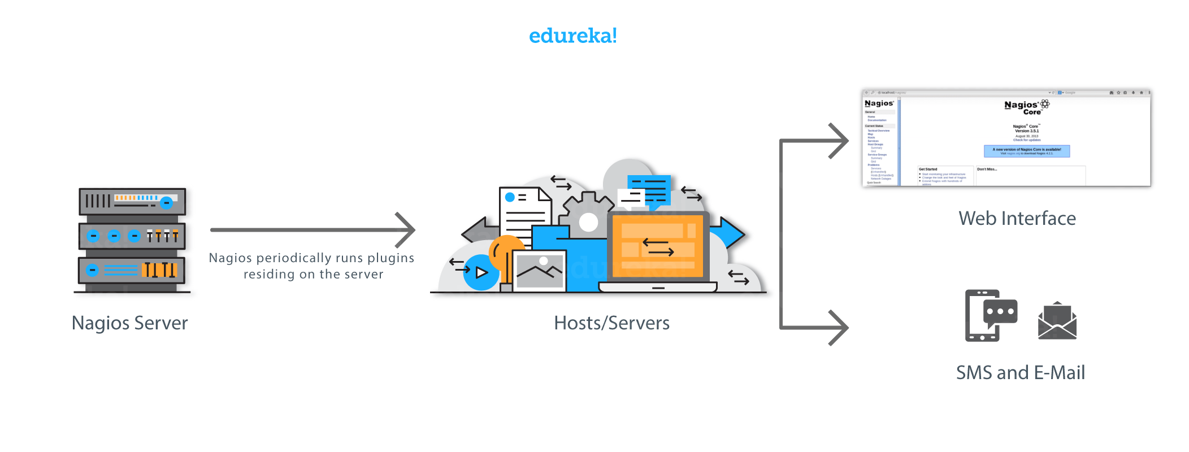
How Nagios works: a basic workflow diagram
Nagios runs on a server, usually as a daemon or a service.
It periodically runs plugins residing on the same server, they contact hosts or servers on your network or on the internet. One can view the status information using the web interface. You can also receive email or SMS notifications if something happens.
The Nagios daemon behaves like a scheduler that runs certain scripts at certain moments. It stores the results of those scripts and will run other scripts if these results change.

Slide 19
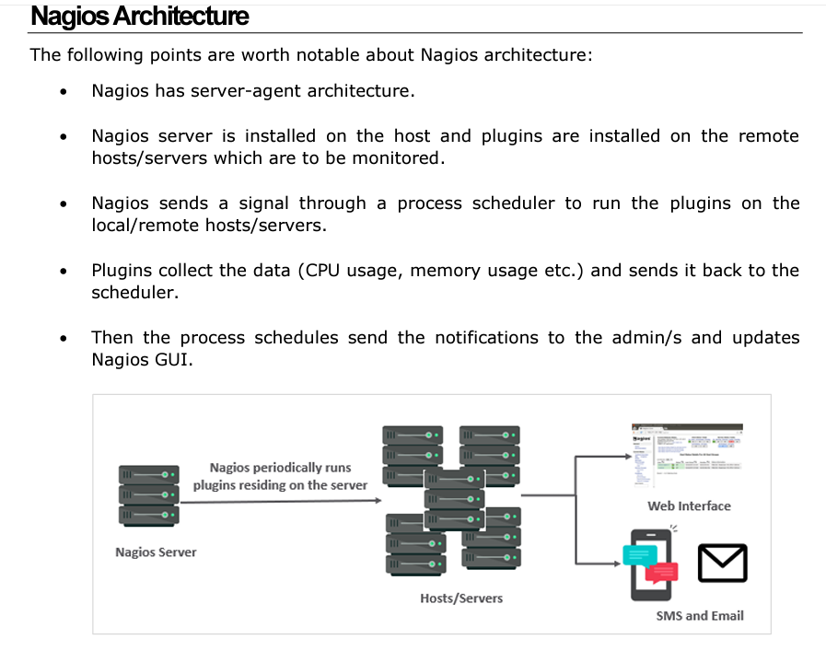

Slide 20
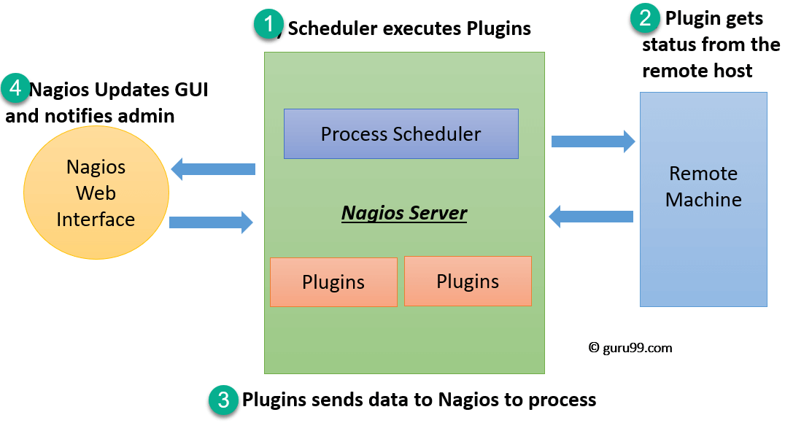
The following figure shows Nagios Server Agent Architecture in detail:
Nagios process scheduler:-The scheduler is a component of server part of Nagios. It sends a signal to execute the plugins at the remote host.
Plugins: These are compiled executables or scripts (Perl scripts, shell scripts, etc.) that can be run from a command line to check the status or a host or service. Nagios uses the results from the plugins to determine the current status of the hosts and services on your network.
The plugin gets the status from the remote host
The plugin sends the data to the process scheduler
The process scheduler updates the GUI and notifications are sent to admins

Slide 21
Nagios offers the following benefits for the users:
It helps in getting rid of periodic testing.
It detects instantaneous failures
It reduces maintenance cost without sacrificing performance.
It provides timely notification to the management of control and breakdown.

Slide 22
munin
You are a system administrator, managing a set of servers. As a part of your job, you need to ensure that all the servers are up and running 24X7, they are resources are utilized optimally. And that no single server is overloaded or consuming huge memory or some similar abnormal behaviour over a time period. Obviously, you will be needing a monitoring tool. Munin is one such tool, which helps system administrators to keep track of system resources.
Munin is a open-source ,web based computer system monitoring, network monitoring and infrastructure monitoring tool.
It is designed around a client-server architecture and can be configured to monitor the machine it’s installed on (the Munin master) and any number of client machines, which in Munin parlance, are called Munin nodes.
Munin is written in Perl. Its emphasis is on plug and play capabilities. About 500 monitoring plugins are currently available.

Slide 23
Munin is a system, network, and infrastructure monitoring application that provides monitoring information in the graphical from with the help of graphs.
Munin uses RRD tool(round-robin database tool) to create graphs.
aims to handle time series data such as network bandwidth, temperatures or CPU load.

Slide 24
munin shows network usage of servers and services in graphical form using RRDtool. With the help of Munin you can monitor the performance of your systems, networks, SANS’s(SANS stands for SysAdmin, Audit, Network, and Security) and applications.
With Munin, real-time information about the servers, applications, services, SANs, network, and many more resources is available in graphs through a web interface.
And Munin is easy to set up and deploy with its plug-and-play capabilities(A user can add and remove devices without having to do manual configuration, and without knowledge of computer hardware.) and a popular monitoring tool for web servers and hosts.

Slide 25
How does it work?
Munin the monitoring tool surveys all your computers and remembers what it saw.
It presents all the information in graphs through a web interface. Its emphasis is on plug and play capabilities.
After completing an installation, a high number of monitoring plugins will be playing with no more effort.
Using Munin you can easily monitor the performance of your computers, networks, SANs, applications.
It makes it easy to determine "what's different today" when a performance problem crops up. It makes it easy to see how you're doing capacity-wise on any resources.

Slide 26
Munin uses the excellent ​RRD Tool and the framework is written in Perl, while plugins may be written in any language.
Munin has a master/node architecture in which the master connects to all the nodes at regular intervals and asks them for data.
It then stores the data in RRD files, and (if needed) updates the graphs.

Slide 27
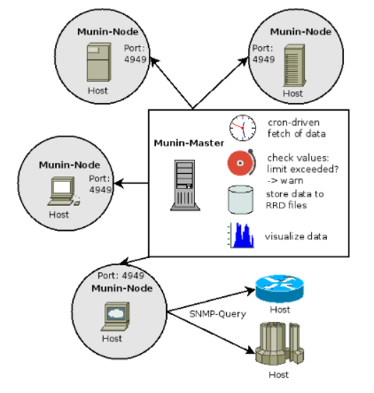
Munin Architecture
This monitoring tool uses Master-node architecture. Master periodically pulls data from all the configured nodes and processes it to create graphical dashboards.

Slide 28
Work flow
Munin derives its name from mythology. It means memory. This monitoring software memorizes what it sees and hence the name.
This monitoring tool uses Master-node architecture. Master periodically pulls data from all the configured nodes and processes it to create graphical dashboards.
One of the advantages of Munin is its vast plugin eco-system. There are several hundred plugins available, which make it a powerful monitoring system.
Munin itself uses RRDTool, which is written in Perl, whereas plugins could be written in any language.
Once data is collected from nodes, it is processed by the master and various graphs are made available on the dashboard.
One of the components is – Munin-limits – which monitors the values between configured “ok”, “warn” and “crit” levels and can create a notification for the administrators.

Slide 29
Munin actually consists of two parts, namely :
1.Munin Master and
2. Munin node.
1.Munin master or Server
Munin master or Server is the data gatherer and grapher which also hosts the software website. The munin master is responsible for gathering data from Munin nodes
master connects to each node regularly and pulls the data from them. i.e.,The Munin Server will periodically poll all the nodes in your network, it’s aware of for data, which is, in turn, will use to create graphs and HTML pages for viewing via a web browser.
It then uses RRDtool to log and generate updated graphs.
It stores this data in RRD, files, and graphs them on request. It also checks whether the fetched values fell below or go over specific thresholds (warning, critical) and will send alerts if this happens and the administrator configured it to do so.

Slide 30
2.Munin node.
With the Munin master server, we can now configure the Munin nodes.
These have an agent on them, called munin-node.
Munin Node is the agent that monitors and extracts data from the node it runs on and then passes the data to the server for further processing.so, munin node can be called as a data collector for munin. Then the master uses this data to gather the information and present to the user.
3.Plugins
Plugins are small, standalone executables. They are easy to write, and can be written in any language.

Slide 31
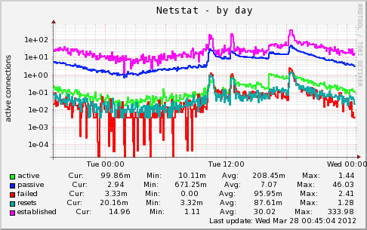

Slide 32
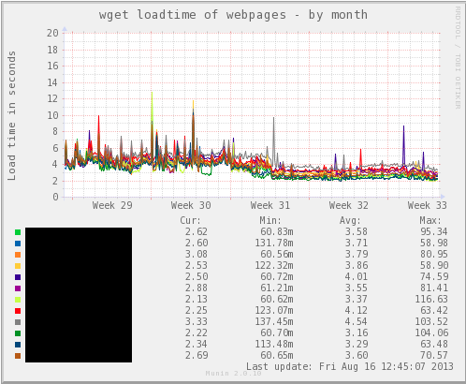

Slide 33
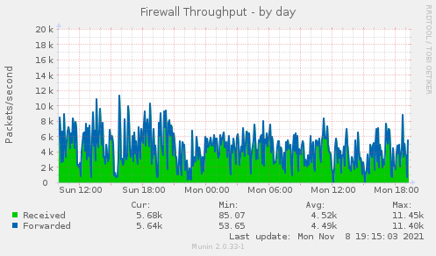

Slide 34
Ganglia
With the size of an organisation’s infrastructure increasing, monitoring is becoming a challenge.
Monitoring multiple data centres is becoming a difficult to deal task for sys admins, and it certainly starts to become tiresome(impatient) as the number of nodes increase rapidly. System administrators would typically want to check systems statistics like the disk, CPU and network utilisation, etc.
They would be interested in knowing whether systems are performing within thresholds, where the bottlenecks are occurring, and how applications are performing. Now, when managing a few systems, you could probably log in to each system and check —it becomes a problem as infrastructure grows.
Ganglia presents itself as a very good solution when it comes to cluster-based monitoring, and analysing the available data.

Slide 35
ganglia is an open-source scalable distributed monitoring system for high-performance computing systems such as clusters and Grids.
Ganglia allows you to gather important information about machines where it is applied.
It allows the user to remotely view live or historical statistics (such as CPU load averages or network utilization) for all machines that are being monitored.
Ganglia is currently in use on thousands of clusters around the world and can scale to handle clusters with several thousand of nodes.

Slide 36
Here is a small glossary of terms used in Ganglia:
Host/node: Typically, a machine.
Cluster: A group of nodes.
Grid: A group of clusters.
Metrics: The graphs that are displayed.
RRDs or Round Robin Databases: RRDtool (the Round Robin Database tool) is a system to store and display time-series data (e.g., network bandwidth, machine-room temperature, server load average, etc). It stores the data very compactly to maintain a manageable archive size. RRDtool presents useful graphs by processing the data to enforce a certain data density.
It leverages widely used technologies such as XML for data representation, XDR for compact, portable data transport, and RRDtool for data storage and visualisation.”
It is carefully engineered to achieve very low per-node overheads and high concurrency.

Slide 37
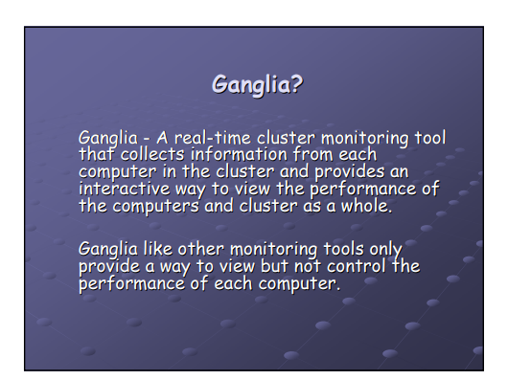

Slide 38
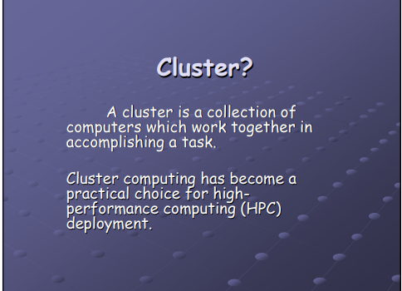

Slide 39
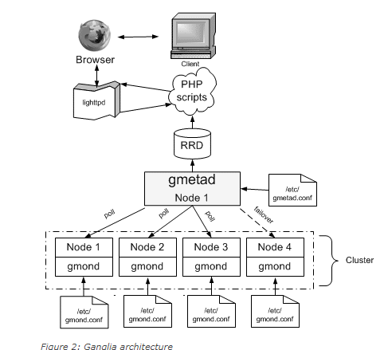
Ganglia architecture

Slide 40
(gmond )Ganglia monitoring daemon
gmond is installed on all nodes that need to be monitored.
Runs on every node of the cluster and collects data about the node like CPU load,free memory,disk usage,network traffic etc.
It monitors the changes in host state, listens to other gmond instances over multi-cast/unicast, and is responsible for sending XML, over a TCP connection, to gmetad.
Gmetad
Runs on a head node, gathers the data from all the nodes, and displays it.
gmetad collects information from multiple gmond or gmetad sources. It saves the information to a local round-robin database, and exports (in XML) a concatenation of all the data sources.
Ganglia PHP Web frontend
The frontend presents the data collected by gmond and gmetad in a meaningful form. Ganglia has been around for many years without much change to the UI — but since October 2010, a few contributors began contributing to a new UI, which looks awesome
RRDs are Round-Robin Databases. The data is archived after each hour is stored in an average form. You can demand the exact value of a particular instance of a particular month and hour.

Slide 41
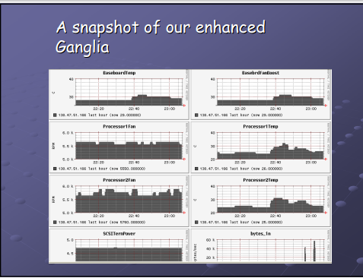

Slide 42
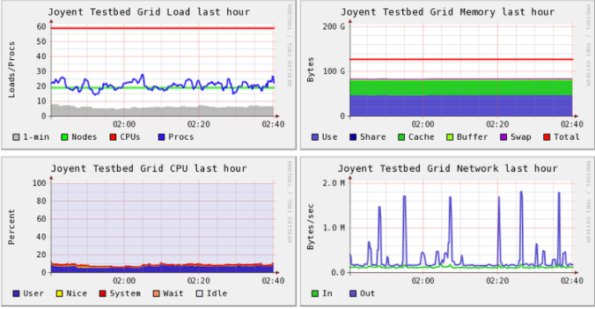

Slide 43
Log Handling
It’s important for IT teams to continue having complete visibility of every component related to their applications and the underlying infrastructure. This is where real-time log monitoring and analysis come in.
What Are Logs?
All applications, networking devices, workstations, and servers create logs—or records of events—which are written to files on local disks by default. These logs contain crucial information. For example, an event log from a web server can contain information like a user’s IP address, date, time, request type, and more. Logs provide administrators with an audit trail to find the root cause of problems and troubleshoot errors. Because there’s a wide range of logs, they often vary in format.
Logs are typically recorded in one or more log files. Log management allows you to gather the data in one place and look at it as part of a whole instead of separate entities. As such, you can analyze the collected log data, identify issues and patterns so that you can paint a clear and visual picture of how all your systems perform at any given moment.
Log file
Log file is a file that records either messages or events that occur in an operating system/application. These messages are written to log file.

Slide 44
Log management :-
Log management is the process of handling log events generated by all software applications and infrastructure on which they run. It involves log collection, aggregation, parsing, storage, analysis, search, archiving, and disposal, with the ultimate goal of using the data for troubleshooting and gaining business insights, while also ensuring the compliance and security of applications and infrastructure.
What Is Log Monitoring?
Log monitoring refers to the set of practices involved in log management and analysis to help IT teams manage their infrastructure and operations
Why is Log Analysis Becoming More Important?
In today’s competitive world, organizations cannot afford one second of downtime or slow performance of their applications. Performance issues can damage a brand and in some cases translate into a direct revenue loss.

Slide 45
Log Monitoring:-
Web Server Monitoring :You can track traffic volume, server errors, failed services, and more with server logs.
Network Monitoring :Devices like routers, firewalls, and load balancers form the backbone of enterprise networks.
Application Monitoring: While metrics give aggregated information about the health of different services over time
Database Monitoring: Database logs from MongoDB, MySQL, PostgreSQL, etc., can help in proactive monitoring and troubleshooting database errors.

Slide 46

ELK ELK Stack
Stack
ELK Stack
ELK Stack is the leading open-source IT log management solution for companies who want the benefits of a centralized logging solution without the enterprise software price.
Elasticsearch, Logstash, and Kibana when used together, form an end-to-end stack (ELK Stack) and real-time data analytics tool that provides actionable insights from almost any type of structured and unstructured data source.
Each of these products plays a different role in delivering one seamless stack:
Elasticsearch provides the storage and analytics engine
Logstash acts as a collection and transformation agent
Kibana helps you visualize the data that you have
ELK Stack

Slide 47
Introduction to issue trackers
An issue in Issue Tracker is a bug report, feature request, change request or process workflow item that a user wants to track or expects another user or team to track.
We can also say, An issue is any problem, question, grievance, or criticism offered by a user. When your customers experience a challenge while using your product, then they have encountered an issue.
Each issue has a set of associated fields that describe it and its current state. This includes the type of issue, its importance in terms of severity and priority, and the record of activity on the issue
Issue tracker:- an Issue tracker records issues customers have experienced with a software product, and it enables support agents, engineers, and managers to track those problems until they have been successfully resolved. Often referred to as a bug tracking system, these tools present an organized way—via tickets—for customer service and product development teams to address issues efficiently while also providing users with timely status updates.
Issue tracking
Issue tracking is the process of monitoring problems that users are experiencing with a software product. While issue tracking primarily came about as a solution for tracking problems in software.

Slide 48
Issue Tracking System
An issue tracking system (also ITS, trouble ticket system, support ticket, request management or incident ticket system) is a computer software package or application that manages and maintains lists of issues, and also allows you to record and follow the progress of every customer ticket or "issue" in your inbox until the problem is resolved.
In a typical issue tracking system, a customer service agent can assign a priority level to a ticket (for example, P1 for the most severe of issues to P4 for the least). Those priority levels will often be adjusted by development teams’ project managers based on team resources, development roadmaps, and feasibility.
How are issue tracking tools used?
Issue tracking systems are most commonly used for handling bugs. For example, when a user attempts to perform an action in a software product—such as logging in, exporting data, or creating a dashboard for analytics—and cannot complete the task, he or she will likely contact the company for help. That customer will contact the business via one of the available support channels. When the user makes that initial contact, the issue tracking system creates a ticket, which is assigned to a customer support agent. That agent might also choose the ticket rather than be assigned it, depending on how the support teams’ workflow has been set up.

Slide 49
Issue tracking used in development and testing:-
Issue tracking is the process of logging and monitoring bugs or errors during software testing. It is also referred to as defect tracking or issue tracking.
In IT, a bug refers to an error, fault, defects or flaw in any computer program or a hardware system. A bug produces unexpected results or causes a system to behave unexpectedly. In short it is any behavior or result that a program or system gets but it was not designed to do.
Large systems may have hundreds or thousands of defects.
Each needs to be evaluated, monitored and prioritized for debugging. In some cases, bugs may need to be tracked over a long period of time.
“Defect tracking is an important process in software engineering, as complex and business critical systems have hundreds of defects,”.
One of the challenging factors is managing, evaluating and prioritizing these defects. The number of defects gets multiplied over a period of time and to effectively manage them, a defect tracking system is used to make the job easier."

Slide 50
How bug tracking or defect tracking works
A software bug occurs when an application or program doesn’t work the way it is designed to function. Most errors are faults or mistakes made by system architects, designers or developers.
Testing teams use bug tracking to monitor and report on errors that occur as an application is developed and tested.
“A major component of a bug tracking system is a database that records facts about known bugs,”.
Facts may include the time a bug was reported, its severity, the erroneous program behavior and details on how to reproduce the bug; as well as the identity of the person who reported it and any programmers who may be fixing it.”
What is Defect Life Cycle or a Bug life cycle?
Defect Life Cycle or Bug Life Cycle in software testing is the specific set of states that defect or bug goes through in its entire life.
The purpose of Defect life cycle is to easily coordinate and communicate current status of defect which changes to various assignees and make the defect fixing process systematic and efficient.

Slide 51
Defect Status
Defect Status or Bug Status in defect life cycle is the present state from which the defect or a bug is currently undergoing.
The goal of defect status is to precisely convey the current state or progress of a defect or bug in order to better track and understand the actual progress of the defect life cycle.
The number of states that a defect goes through varies from project to project. Below lifecycle diagram, covers all possible states

Slide 52
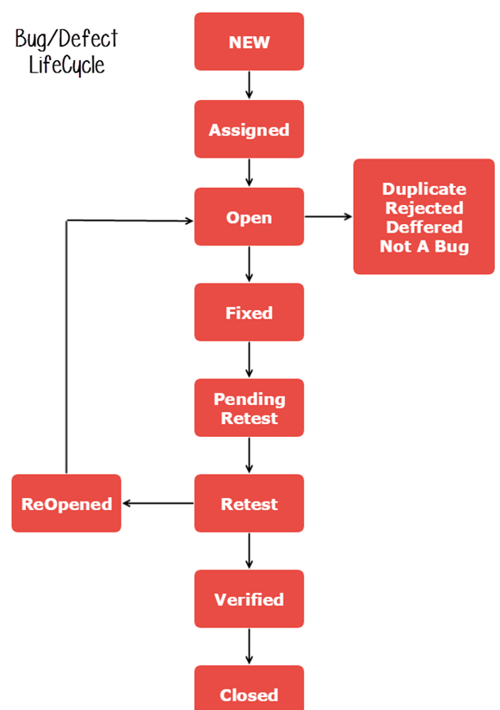

Slide 53
New: When a new defect is logged and posted for the first time. It is assigned a status as NEW.
Assigned: Once the bug is posted by the tester, the lead of the tester approves the bug and assigns the bug to the developer team
Open: The developer starts analyzing and works on the defect fix
Fixed: When developer makes necessary code change and verifies change, he or she can make bug status as “Fixed.
Pending retest: Once the defect is fixed the developer gives a particular code for retesting the code to the tester. Since the software testing remains pending from the testers end, the status assigned is “pending retest.”
Retest: Tester does the retesting of the code at this stage to check whether the defect is fixed by the developer or not and changes the status to “Re-test.”
Verified: The tester re-tests the bug after it got fixed by the developer. If there is no bug detected in the software, then the bug is fixed and the status assigned is “verified.”
Reopen: If the bug persists even after the developer has fixed the bug, the tester changes the status to “reopened”. Once again the bug goes through the life cycle.

Slide 54
Closed: If the bug is no longer exists then tester assigns the status “Closed.”
Duplicate: If the defect is repeated twice or the defect corresponds to the same concept of the bug, the status is changed to “duplicate
Rejected: If the developer feels the defect is not a genuine defect then it changes the defect to “rejected.”
Deferred: If the present bug is not of a prime priority and if it is expected to get fixed in the next release, then status “Deferred” is assigned to such bugs
Not a bug:If it does not affect the functionality of the application then the status assigned to a bug is “Not a bug”.

Slide 55
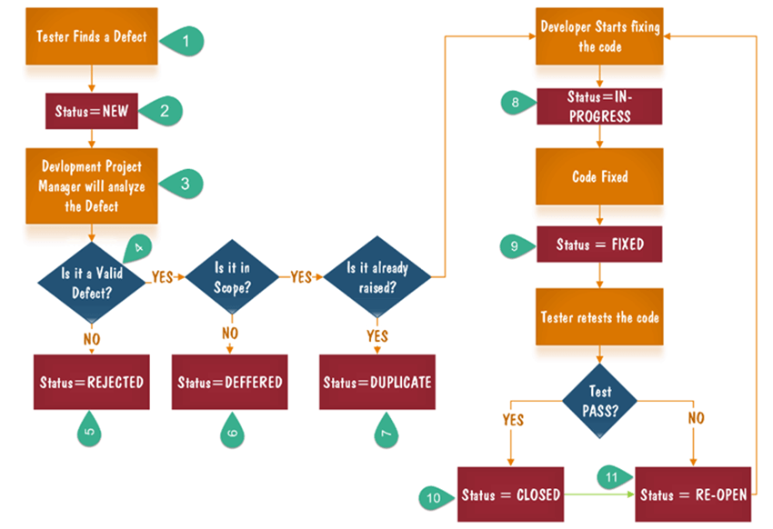
Bug Life Cycle with Flow chart:-

Slide 56
Tester finds the defect
Status assigned to defect- New
A defect is forwarded to Project Manager for analyze
Project Manager decides whether a defect is valid
Here the defect is not valid- a status is given “Rejected.”
So, project manager assigns a status rejected. If the defect is not rejected then the next step is to check whether it is in scope. Suppose we have another function- email functionality for the same application, and you find a problem with that. But it is not a part of the current release when such defects are assigned as a postponed or deferred status.
Next, the manager verifies whether a similar defect was raised earlier. If yes defect is assigned a status duplicate.

Slide 57
8.If no the defect is assigned to the developer who starts fixing the code. During this stage, the defect is assigned a status in- progress.
9.Once the code is fixed. A defect is assigned a status fixed
10.Next, the tester will re-test the code. In case, the Test Case passes the defect is closed. If the test cases fail again, the defect is re-opened and assigned to the developer.
11.Consider a situation where during the 1st release of Flight Reservation a defect was found in Fax order that was fixed and assigned a status closed. During the second upgrade release the same defect again re-surfaced. In such cases, a closed defect will be re-opened.

Slide 58
Need of issue tracker
An issue tracker is software that allows developers, managers, and customer support agents to organize, prioritize, and track these issues and bugs until they are resolved. Issue tracking systems, commonly referred to as ITS
Software testing is essential for isolating and mitigating errors. A good QA process can uncover hundreds or even thousands of defects, and testing teams need to manage all of them.
Integrating bug tracking or issue tracking into the testing workflow improves efficiency by helping testers prioritize, monitor and report on the status of each error.
“Defect tracking helps ensure that bugs found in the system actually get fixed,”
Ideally, testing should be done as soon as possible .finding bugs in early stages are easier and far less costly to fix. That defects found post-production or after release can cost 15 times more to fix compared to errors resolved early in development.
Many teams are now using a methodology known as continuous testing. In this case, quality testing and feedback are conducted at all stages of development.

Slide 59
Why is an issue tracker important?
Issue trackers have several key benefits:-
Centralized issue management: when all existing and solved bugs are stored in one central database, it’s easier for developers, project managers, and other team members to find relevant solutions quickly.
Issue history tracking: an issue tracker enables teams to keep track of repetitive issues and effortlessly find answers to them.
Appropriate delegation of work: a central issue tracker improves delegation. For example, if there’s a problem with your app’s UI, you can instantly assign the issue to the design team.
Monitor actions related to every issue: relevant teams can get real-time updates about every step taken to solve an issue, so everyone is up-to-date on ongoing and solved bugs.
Improved information sharing: when every issue can be tracked at a single glance, client-facing teams can give users timely updates to show you’re working on a solution and, consequently, boost customer satisfaction.
Automated reminders: you can’t take forever to fix issues. Customers and clients have limited patience. A bug reporting system with automated reminders ensures you never miss a deadline.

Slide 60
Increased efficiency: a centralized issue tracker allows you to identify more effective methods used by other teams and implement these best practices in your team’s processes.
Better collaboration: software developers aren’t the only ones involved in fixing bugs. Customer service reps, the QA team, and any other relevant teams all have to pitch in. You can streamline this collaboration with dynamic bug tracking software.
You can keep track of every issue, regardless of the department or the nature of the problem:-An issue tracking system allows you to rapidly access answers and information and maintain a dashboard for tracking the history of issues and solutions. This makes creating reports, monitoring issues, and sharing information far easier.
You can monitor any action that has been taken on an issue:- Once an issue has been submitted, it’s important to stay track of who’s responsible for resolving it.
If it needs to be escalated or dealt with by another department, the issue tracking software will show the status of the query and the project ‘ownership.’ A good issue tracking system will allow you to track any actions taken on an issue with a quick glance on a dashboard. Automated reminders and status updates keep everyone in the loop.
You can keep people informed about what has happened with each issue. This is key for customer satisfaction and business efficiency. The more issues there are, the more staff who could interact with the issue – all these factors mean that issues can easily become lost or confused.

Slide 61
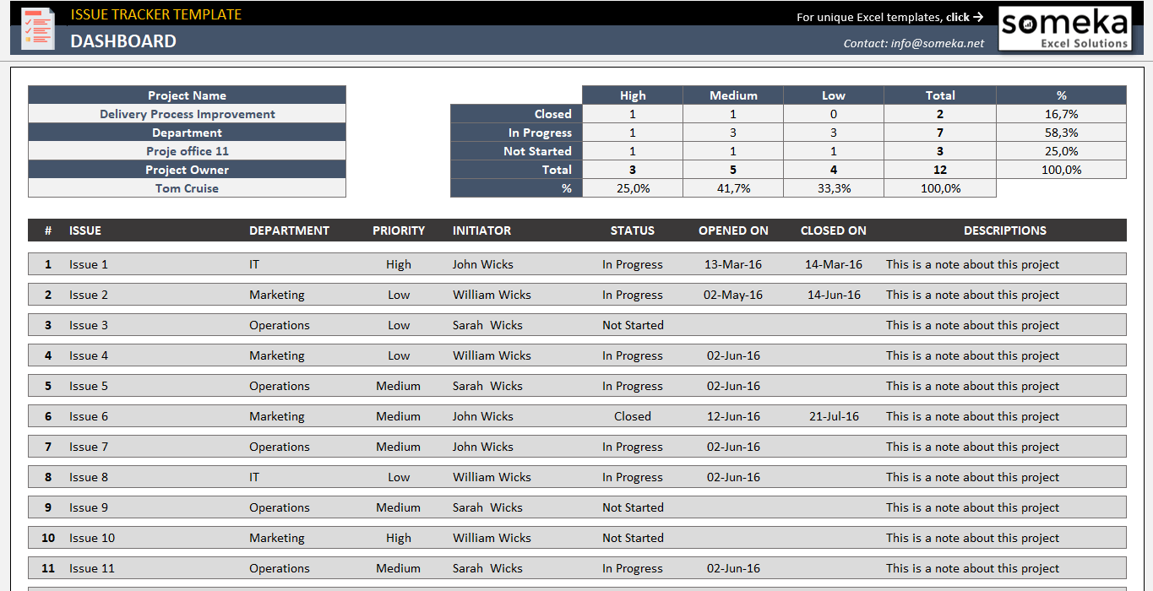
An issue tracking system streamlines management for even the most complex issues, complaints, or special requests. People who know their requests and submissions have been understood and answered are far more likely to remain loyal customers or efficient, satisfied employees.
Issue tracking software systems are easy and intuitive – and affordable. Any organization can improve its bottom line, staff satisfaction and customer retention using issue tracking software.

Slide 62
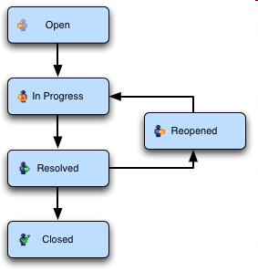
Some examples of workflows and issues
What is an “Issue”?
Any task that requires an action from a person
What is “Workflow”?
A workflow is some series of steps
that need to be Carried out :
What are fields?
The attributes of an issue (Standard & Custom)

Slide 63
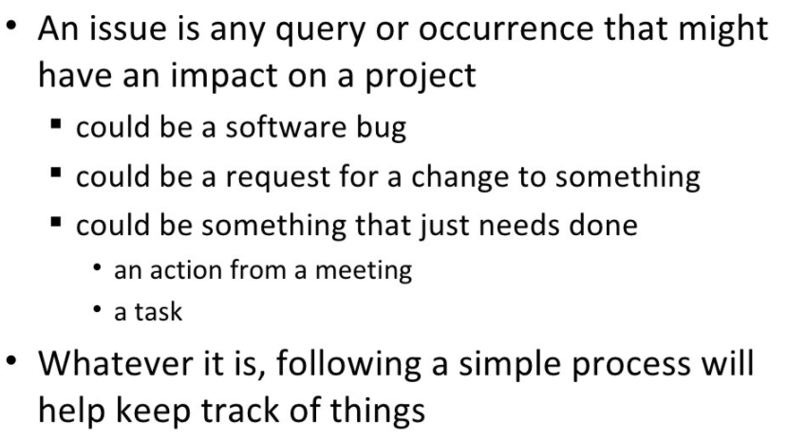

Slide 64
The terms "ticket" or "bug". Technically, they are the same thing. An issue might also represent a to-do item, enhancement request, or any other type of work item.
An issue has various metadata associated with it, depending on what it represents and what the issue tracker supports. The most basic type of issue is very simple, yet useful.
It has the following basic attributes:
Description: This is a free-form textual description of the issue
Reporter: This represents the person who opened the issue
Assigned: This is the person who should work on the item.

Slide 65
States of an issue representing the workflow:-
Open: Here, the developer starts the process of analyzing the defect and works on fixing it, if required.
Closed: When the defect does not exist any longer, then the tester changes the status of the defect to “Closed”.
Rejected: If the defect is not considered a genuine defect by the developer then it is marked as “Rejected” by the developer.
Duplicate: If the developer finds the defect as same as any other defect or if the concept of the defect matches any other defect then the status of the defect is changed to ‘Duplicate’ by the developer.
Deferred: If the developer feels that the defect is not of very important priority and it can get fixed in the next releases or so in such a case, he can change the status of the defect as ‘Deferred’.
Not a Bug: If the defect does not have an impact on the functionality of the application, then the status of the defect gets changed to “Not a Bug”.

Slide 66
Other attributes of an issue:-
Due date: The date on which the issue is expected to be resolved.
Milestone: A milestone is a way to group issues together in useful work packages that are larger than a single issue. A milestone can represent the output from a Scrum sprint, for example. A milestone usually also has a due date, and if you use the milestone feature, the due dates on individual issues are normally not used.
Attachments: It might be convenient to be able to attach screenshots and documents to an issue, which might be useful for the developer working on the issue or the tester verifying it.
Work estimates: It can be useful to have an estimate of the expected work expenditure required to resolve the issue. This can be used for planning purposes. Likewise, a field with the actual time spent on the issue can also be useful for various calculations.

Slide 67
Jira
JIRA is a tool or a software used for bug tracking, issue tracking, and project management.
The basic use of this tool is to track issue and bugs related to your software and Mobile apps. It is widely used as an issue-tracking tool for all types of testing.
JIRA is also a project management tool. JIRA is mainly used by agile development teams to customize your workflows, team collaboration, and release software with confidence.
But today, Jira has evolved into a powerful work management tool for all kinds of use cases, from requirements and test case management to agile software development.
The JIRA dashboard consists of many useful functions and features which make handling of issues easy.
Jira allows teams to break down their work into easily manageable portions and assign them to the right people. Teams can also create a customized workflow for these projects to ensure they are done on time.
Its primary purpose is to help you with the following:
Manage Agile and Scrum teams
Organize your project tasks
Capture and record software bugs

Slide 68
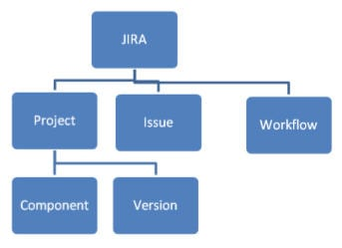
Basics Of JIRA Tool
JIRA in its entirety is based on 3 concepts.
Issue: Every task, bug, enhancement request; basically anything to be created and tracked is considered an Issue.
Project: A collection of activities or tasks.
Workflow: A workflow is simply the series of steps an issue goes through starting from creation to completion.
Say the issue first gets created, goes to being worked on and when complete gets closed. The workflow in this case is:

Slide 69
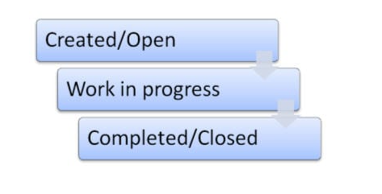
JIRA Issues and Issue types:
What is JIRA Issue?
JIRA issue would track bug or issue that underlies the project. Once you have imported project then you can create issues.
Under Issues, you will find other useful features like
Issue Types
Workflow’s
Screens
Fields
Issue Attributes

Slide 70
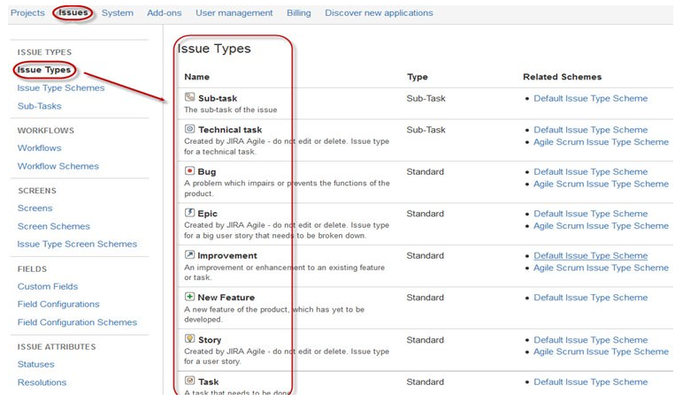
i)Jira Issue Types
Issue Type displays all types of items that can be created and tracked via Jira testing tool. JIRA Issues are classified under various forms like new feature, sub-task, bug, etc. as shown in the screen shot.

Slide 71
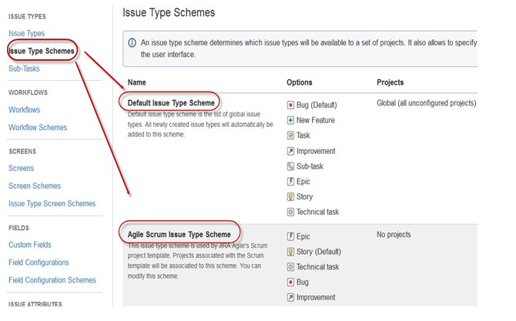
There are two types of Issue types schemes in Jira project management tool, one is
Default Issue Type Scheme: In default issue type scheme all newly created issues will be added automatically to this scheme
Agile Scrum Issue Type Scheme: Issues and project associated with Agile Scrum will use this scheme

Slide 72
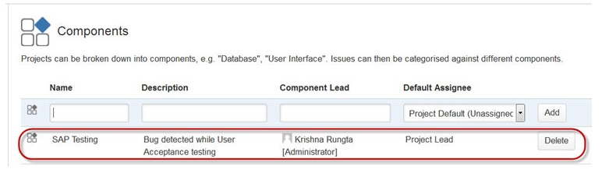
ii)Issue fields
Each issue has a set of associated fields that describe it and its current state. This includes the type of issue, its importance in terms of severity and priority, and the record of activity on the issue.
iii) JIRA Components
Jira Components are sub-sections of a project; they are used to group issues within a project into smaller parts. Components add some structures to the projects, breaking it up into features, teams, modules, subprojects and more. Using components you can generate reports, collect statistics, and display it on dashboards and so on.

Slide 73
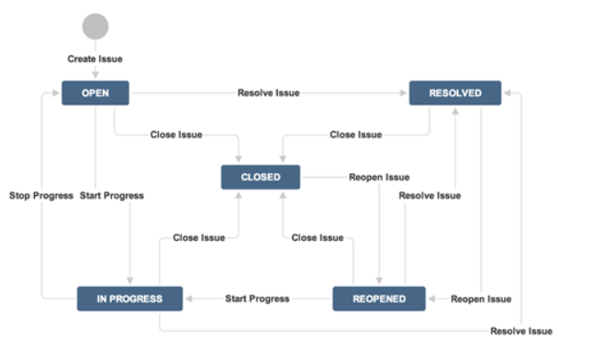
iv)WorkFlows
A JIRA workflow is a set of statuses and transitions that an issue goes through during its lifecycle. JIRA workflow encompasses five main stages once the issue is created.
Open Issue
Resolved Issue
InProgress Issue
ReOpened Issue
Close Issue

Slide 74
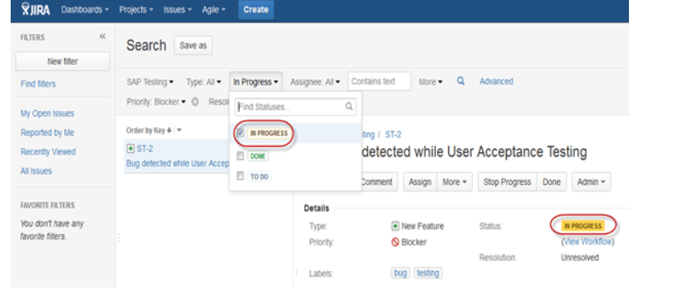
While workflow in JIRA comprises of Statuses, assignee, resolution, conditions, validators, post-function’s and properties
Statuses: It represents the positions of the issues within a workflow
Transitions: Transitions are the bridges between statuses, the way a particular issue moves from one status to another
Assignee: The assignee dictates the responsible party for any given issue and determines how the task would be executed
Resolution: It explains why an issue transitions from an open status to a closed one
Conditions: Conditions control who can perform a transition
Validators: It can ensure that the transition can happen given the state of the issue
You can assign the status of the issue from the window itself, when you click on the check box for IN Progress status as shown in screen shot below, it will reflect the status in the issue panel highlighted in yellow.

Slide 76
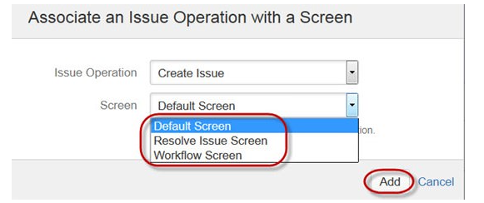
v)JIRA Screen
When issue is created in JIRA, it will be arranged and represented into different fields, this display of field in JIRA is known as a screen. This field can be transitioned and edited through workflow. For each issue, you can assign the screen type as shown in the screen-shot. To add or associate an issue operation with a screen you have to go in main menu and click on Issues then click on Screen Schemes and then click on “Associate an issue operation with a screen” and add the screen according to the requirement.
vi) Jira Issue Attributes
Issue Attributes encompasses
Statuses
Resolutions
Priorities

Slide 77
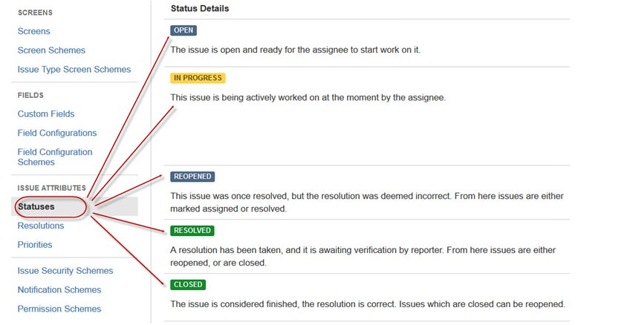
Statuses: Different statuses are used to indicate the progress of a project like To do, InProgress, Open, Closed, ReOpened, and Resolved. Likewise, you have resolutions and priorities, in resolution it again tells about the progress of issue like Fixed, Won’t fix, Duplicate, Incomplete, Cannot reproduce, Done also you can set the priorities of the issue whether an issue is critical, major, minor, blocker and Trivial.

Slide 78
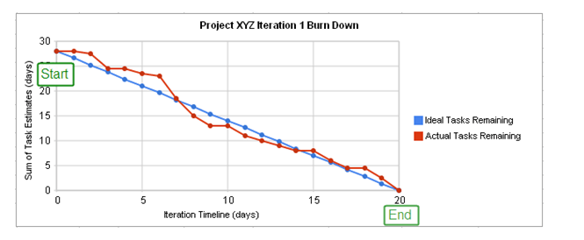
Reports in JIRA
To track the progress in Agile, a Burndown Chart shows the actual and estimated amount of work to be done in the sprint. A typical burndown chart will look somewhat like this, where the red line indicates the actual task remaining while the blue line indicates ideal task remaining during the scrum cycle.
Apart from Burn down chart there are other options available in JIRA automation like Sprint Report, Epic Report, Velocity Chart, Control Chart.

Slide 79
JIRA - Core Features
The following table explains some of the most important and commonly used features in detail for better understanding.
Boards
JIRA supports Scrum and Kanban boards. These boards provide an immediate snapshot of the project to the team.
Helps to quickly review the progress of the project and see the status of the individual tasks.Board workflow can be customized to fulfil the way a team wants to proceed.
Jira Dashboard
The dashboard is the first thing when we login in the jira software. Here the admin can customise the dashboard’s view and the things displayed on it.
Business Project Template
JIRA supports n number of business templates to manage simple tasks and complex tasks like workflow.
Template can be customized based on the team and their approach. Ex: Workflow can be customized based on each team's approach. Every step is accounted and team can move to achieve their goals.
Task Details
Tasks can be defined at the individual level to track the progress.
Status of every task, comment, attachment and due dates are stored in one place.

Slide 80
Notifications
An email can be sent for a particular task to the users.
Voting and watching features to keep an eye on the progress for the stakeholders.
Use @mention to get the attention of a specific team member at Comments/Description.User will instantly notify if something is assigned or if any feedback is require
Power Search
JIRA supports a powerful search functionality with Basic, Quick and Advanced features.
Use the search tool to find answers like due date, when a task was last updated, what items a team member still needs to finish. Project information at one place, search within a project.
Reports
JIRA supports more than a dozen reports to track progress over a specific timeframe, deadlines, individual’s contribution, etc.
Easy to understand and generate different reports those help to analyse how the team is going on. Easy to configure these reports and display the matrices to the stakeholders
Scale with Team Growth
JIRA supports any business team and any project irrespective of size and complexity.

Slide 81
Multilingual
JIRA supports more than 10 languages those are widely used as English (US, UK, India), French, German, Portuguese, Spanish, Korean, Japanese and Russian.
Jira security
The security settings of jira bug tracking software restricts the access a certain bug only to those people who are allowed to work on a team member of the given security level. There is security feature like default permission scheme.
Custom workflows
In a Jira workflow, colored blocks represent the processes, and arrows show the transitions. These workflows help you keep track of how your software development projects and tasks are progressing.
What makes this feature more powerful is that you can start from scratch and create your own custom workflows too. You can even import workflow templates.

Slide 82
Problems with issue tracker proliferation
The Issue tracker proliferation problem is that:
Sometimes large organization might standardize a type of tracker that few actually like to use.
typical reason is that only the needs of one type of team, such as the quality assurance team or the operations team, is being considered while deciding on an issue tracker.
Another reason is that only a limited amount of licenses were bought for the issue tracker, and the rest of the team will have to make do on their own.

Slide 83
It is also quite common that the developers use one kind of tracker, the quality assurance team another, and the operations team yet another completely different and incompatible system.
single tool that supports both Development and Operation workflows and issue types is ideal to reduce friction and promote reusability and shared understanding
Teams using different tools to track work or defects often have difficulty working together.

Slide 84
Examples:-
Production incidents originating in code or architecture flaws but stored in an issue tracking tool not accessible by Development often end up with incomplete fixes, as context and history is missing.
If these incidents are stored in an issue tracking tool accessible by Operations only, then Development will miss the context and history behind them. It's not uncommon that Development provides a fix that turns out incomplete because they were only told “what” failed, not the “why” and “how”.
3. On the other hand, Development work items stored in a tool not accessible by IT Operations often end up as rushed deployments that do not meet any kind of operational criteria.

Slide 85
BUGZILLA
Bugzilla is an open-source issue/bug tracking system that allows developers to keep track of outstanding problems with their product.
Bugzilla is free, open source software that you can install and use without having to pay any license fee.
Bugzilla is a powerful, Web-based bug or defect-tracking tool originally developed by Mozilla .
It is widely used by many organizations across the globe for reporting and managing bugs.
Defect tracking systems allow developers and testers to track all the outstanding defects. Bugzilla can be linked to other testing tools like JIRA, QC or ALM, etc.
This open bug-tracker enables users to stay connected with their clients or employees, to communicate about problems effectively throughout the data-management chain.
Bugzilla helps users to report bugs, assign bugs, prioritize, and arrange bugs by product and component

Slide 86
Why Bugzilla?
In earlier days, companies relied on shared lists and e-mails to track and update the status of defects reported.
This was, however, an error-prone practice and caused lapse and confusion amongst developers to resolve or ignore significant bugs.
Bugzilla provides an easy way to detect ,manage bugs and report them without much effort.
What does Bugzilla do?
It keeps track of both bugs and changes in code.
It enables easy communication with teammates.
It submits and reviews patches.
It is responsible for quality assurance.
It can dramatically increase the productivity and accountability of an individual by providing a documented workflow and positive feedback for good performance.
Most commercial and defect-tracking software vendors charged enormous licensing fees in the starting days of Bugzilla. As a result, Bugzilla quickly became a favorite among the open-source users, due to its genesis in the open-source browser project with Mozilla. It is now the most precious defect-tracking system against which all the others are measured.

Slide 87
Features of Bugzilla:-
Advanced search capabilities Bugzilla offers a simple search feature also called as a full-text search that spans comments, summaries, and substrings of bugs.
E-mail notification by user preferences Bugzilla gives flexibility to configure e-mail alerts as per their preferences. You can choose to or not to receive e-mails regarding the changes made to bugs. By default, an e-mail notification includes bug ID and summary of the bug report along with a list of the changes
Reports and Charts With Bugzilla, you can generate reports to view the current state of the bug database. Bugzilla also supports a charting system, which can create graphs that track changes in the system over time.
Automatic Duplicate Bug Detection With auto detection feature, you can identify if the bug you are going to file for a product in Bugzilla already exists in the database.

Slide 88
Time tracking With time tracking feature, you can estimate the time a bug will take to fix and the time spent on that bug. You can also set a deadline for the completion of a bug.
Bugzilla displays the complete bug change history. Bugzilla provides inter bug dependency track and graphic representation.
Bugzilla allows users to attach Bug supportive files and manage it.
Who benefits most from using the Bugzilla bug tracking tool?
Organizations involved in multiple software development projects -- especially organizations with large teams of developers and testers -- would find Bugzilla very helpful in their efforts, as it provides them with a convenient centralized location for tracking ongoing initiatives and helps cut down on duplicate and unnecessary work.
All members of the DevOps team, no matter what their involvement is during development, will find the software simple to use.

Slide 89
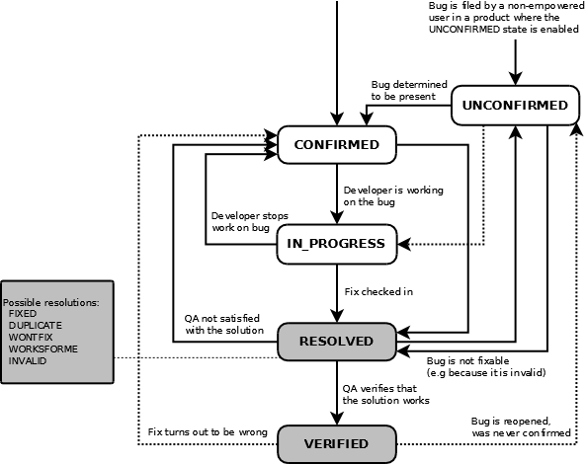
Lifecycle of a Bugzilla Bug

Slide 90
This workflow is configurable, but the default states are as follows:
Unconfirmed: A new bug by a non-EMpowered user begins in the unconfirmed state
Confirmed: If the bug is confirmed to be worthy of investigation, it is put in the confirmed state
In progress: When a developer starts working on resolving the bug, the in progress state is used
Resolved: When developers believe that they have finished fixing the bug, they put it in the resolved state
Verified: When the quality assurance team agrees that the bug is fixed, it is put in the verified state
Advantages of Bugzilla
Improves quality
Improves communication
Increase productivity
Improve customer satisfaction
Reduce costs

Slide 91
GitLab tracker:
The GitLab Issue Tracker is an advanced and complete tool for tracking the issues.
Client constantly pushing out new features and improvements to your product, but with those updates and changes comes the inevitable risk of bugs.
The Issue Tracker is the collection of all issues opened and closed that are created in a project. It is available for all projects, from the moment the project is created.
Gitlab tracker uses gitlab issue boards to tackle and manage issues.
When you access your project's issues, GitLab will present them in a list, and you can use the tabs available to quickly filter by open and closed issues.

Slide 92
GitLab Issues Board:-
The GitLab Issue Board is a software project management tool used to plan, organize, and visualize a workflow for issues and feature or product release.
It can be used as a Kanban or a Scrum board.
It pairs issue tracking and project management, keeping everything together, so that you don’t need to jump between different platforms to organize your workflow.
Issue boards build on the gitlab’s existing issue tracking functionality and and leverage the power of GitLab labels.
GitLab issue labels can be utilized as a lists on a Kanban board. Your issues appear as cards in vertical lists, organized by their assigned labels, milestones, or assignees.

Slide 93
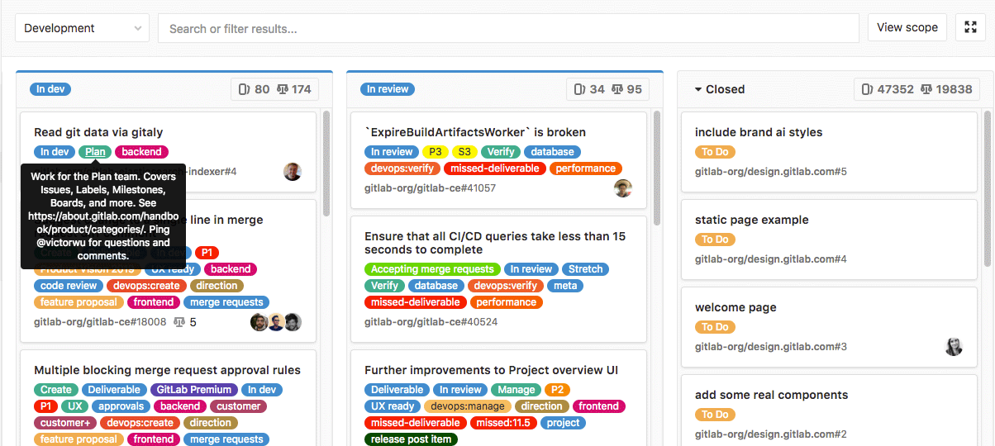

Slide 94
An Issue Board shows you what issues your team is working on, who is assigned to each, and where in the workflow those issues are
Issue boards help you to visualize and manage your entire process in GitLab. You add your labels, and then create the corresponding list for your existing issues. When you’re ready, you can drag your issue cards from one step to another one.
To let your team members organize their own workflows, use multiple issue boards. This allows creating multiple issue boards in the same project.

Slide 95
Components of gitlab Issue Board:-
Create a New Issue
Issues help you summarize your ideas and align the team on a common goal.
Label your issue
Labels make it easy to categorize issues based on descriptive titles. They help teams quickly understand the context of an issue. Labels can be used to describe the issue type, like "new feature," or describe the issue stage, like "QA.“
Navigate to your Issue Board
Issues appear as cards on the Issue Board. They can be arranged across a number of columns using lists.

Slide 96
Create a new list
Lists are based on the labels already created for your project. Each list contains the issues that are assigned to the corresponding label.
Move issues between lists:- Communicate progress on your release and easily adjust your plans right from the Issue Board
Multiple Project Issue Boards :-Create multiple Issue Boards for each of your projects.
It's simple to use:- navigate to your Issue Board, click to open a dropdown menu that will give you the option to create new boards, edit the existing ones, or delete the boards you don't need anymore. Use the same dropdown menu to navigate between your boards.
Group Issue Boards
Create Issue Boards at the group level and manage all issues of the underlying projects in a single and concentrated view.
Lists, labels, and milestones are all managed at the group level, allowing you to focus on the group. This means a team may naturally be working across multiple projects, making it extremely helpful to manage issues across all those projects together.

Slide 97
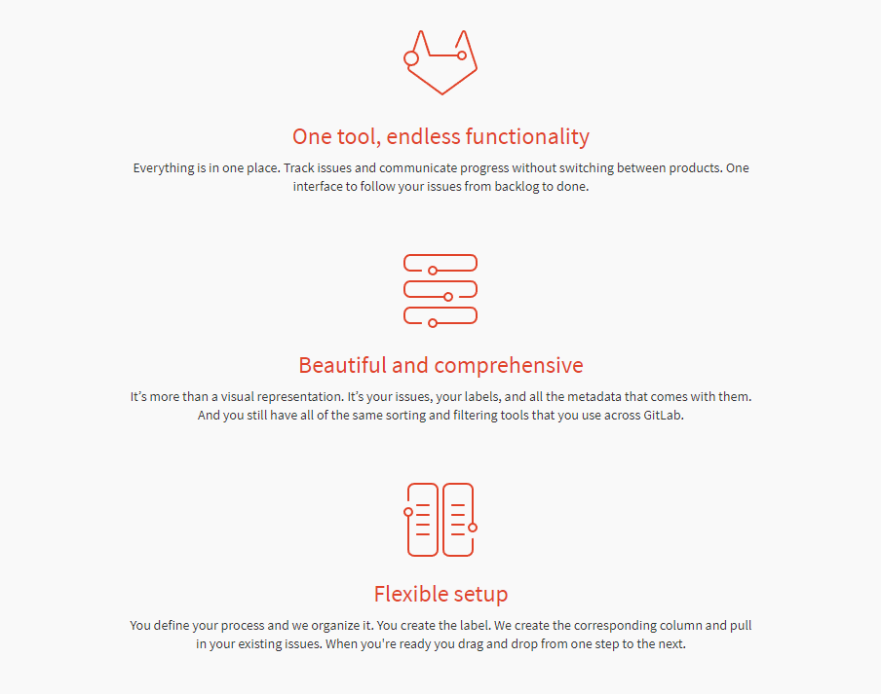
What is GitLab board?

Slide 98
To share reports that are helpful for your developers.
The process is long, complicated, and tracking down the crucial technical information isn’t always easy.
In most teams, reporting bugs into GitLab looks like this:
Find the bug.
Open screenshot tool, capture bug.
Open software to annotate screenshot, add comments.
Open and log into GitLab.
Select the correct project.
Create new issue.
Document the bug.
Add technical information. Attach screenshots.
And then finally: submit report.

Slide 99
